Slide 1
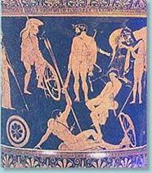
“ The roumanian village/city from the 19th century- the cradle of childhood”
Constanta wish to you “ Welcome dear colleagues!” and invite you also to walk around its streets.

Slide 2
“If somebody would want to designate one capital of Romanian poetry and history,Constanta would have all the chances to be selected on top. This city was built on the ancient city Euxine Pontos. The Antiquity it is currently split from present by just one piece of land. This piece of land it is the way to go back in time over 2500 years and it is symbolic and fragile broden between tow countries of the time. The Milesian have laid the foundation stone in the middle of the VI century BC. They called it TOMIS and also outline the firm under the sign of the eagle and the delphin.

Slide 3
Pontic Heraclea Memnon of History (Asia Minor) recorded his name for the first time in 260 BC. This land it is full of the argonauts legends,ennobled by the hellenistic culture,of Burebista mastery, by the latin culture androman living,by the still unknown tomb of Publius Ovidius Naso,by the crypts of christian martyrs and by the spiritual tomb of the great poet Eminescu. The bustling existence of the city reveals an indisputable fact: the city it was always the tru and rafined basis of the civilization.” – Ovidiu Dunăreanu

Slide 4
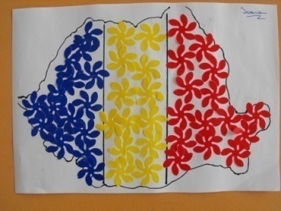
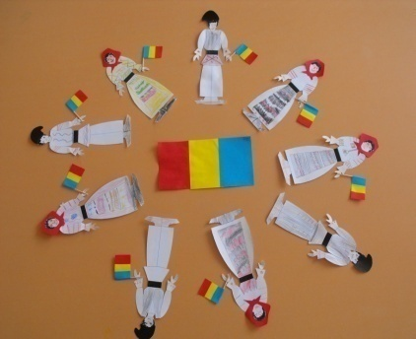
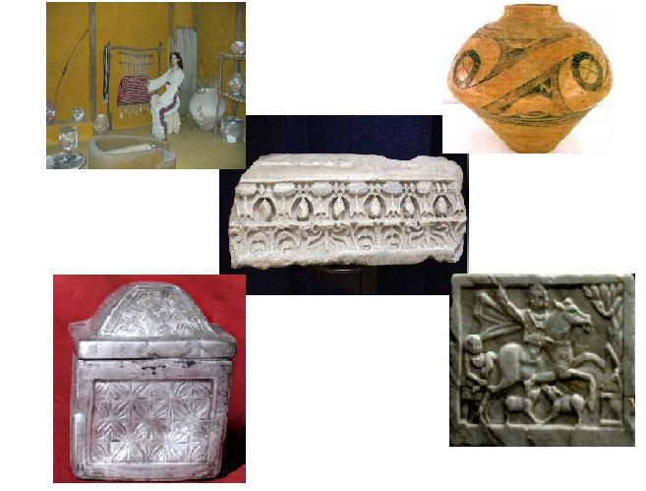
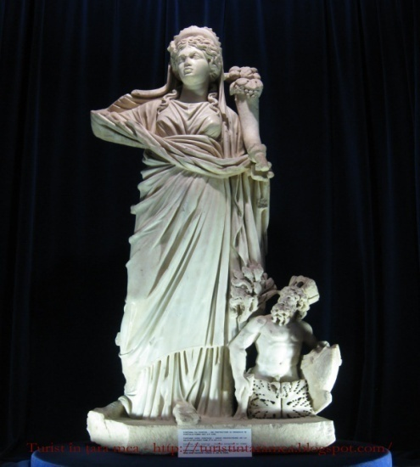
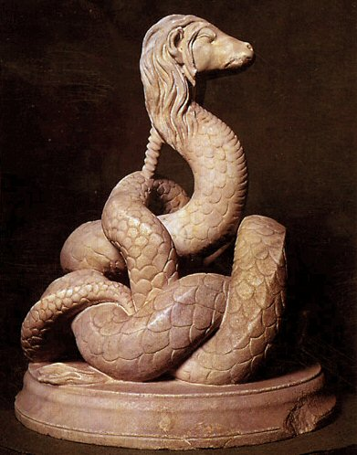
The Museum of National History and Argheologie Constanta

Slide 5
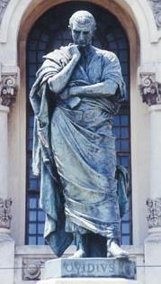
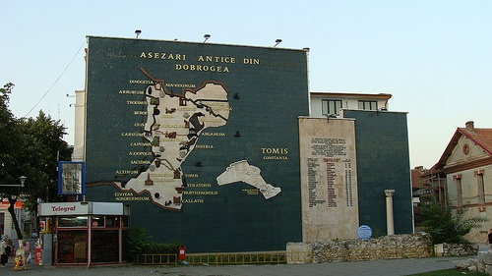
The archaeological Park
The statue of the Publius Ovidius Naso-latin poet
The map of ancient settlements

Slide 6
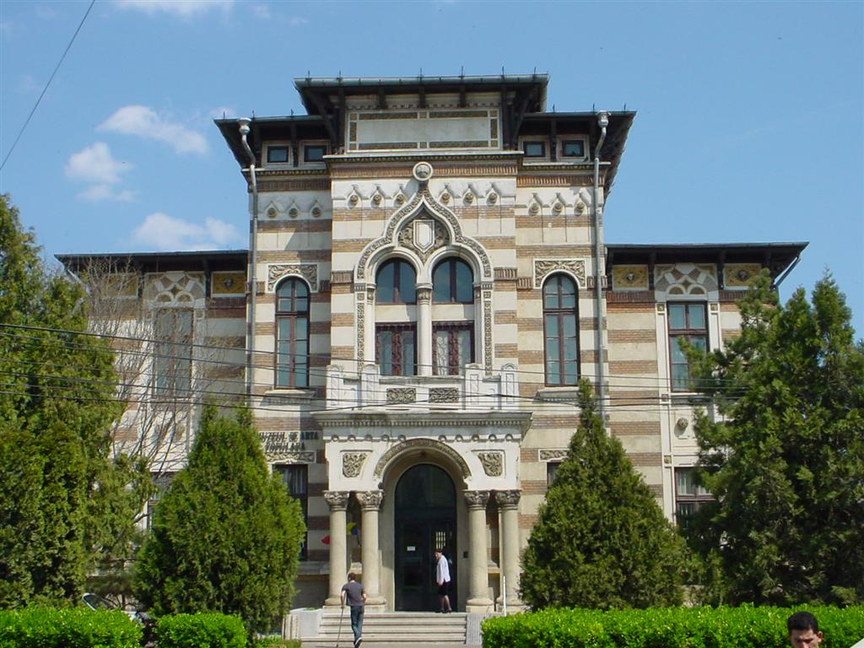
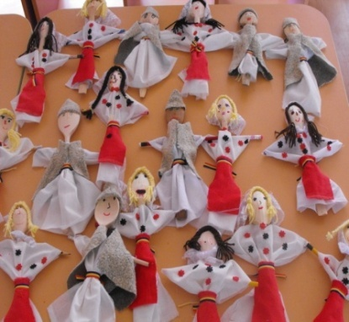
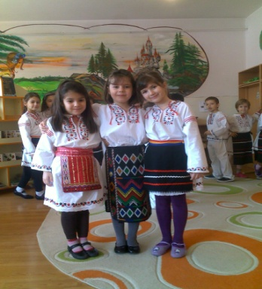
The museum of the romanian navy
The museum of the folk art

Slide 7
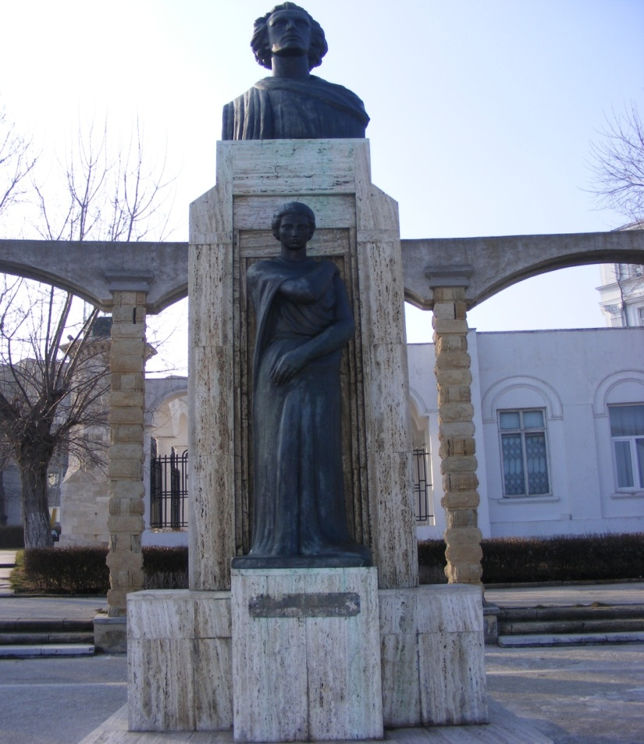
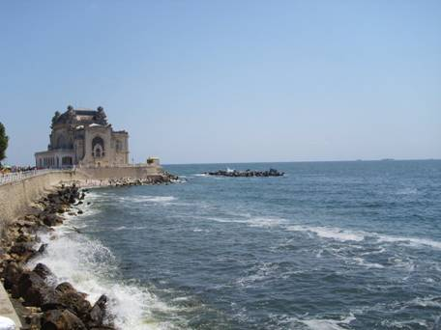
The Casino- the symbol of the city Constanta
The statue of Mihai Eminescu
The statue of Eminescu from Constanta it is situated on the Casino faleya.

Slide 8
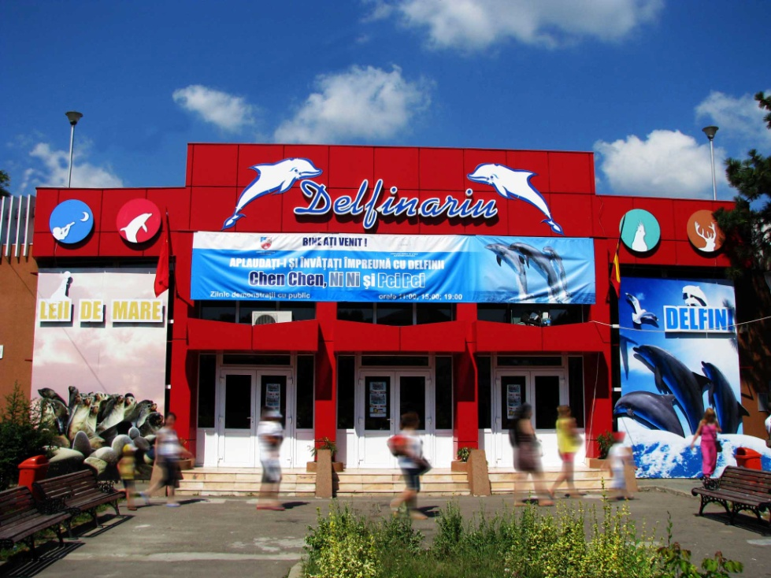
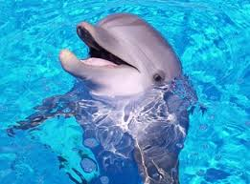
The Dolphinarium
The Aquarium from Constanta

Slide 9
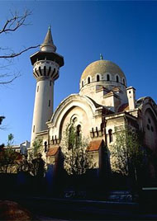
The Orthodox Cathedral of Saints Peter and Pavel
The mosque-muslim cult (built in moorish style
). Mosque can be visited from the high tower. You can see the city view!

Slide 10
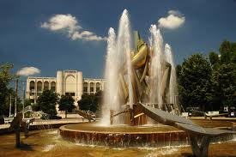
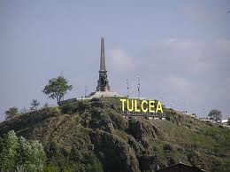
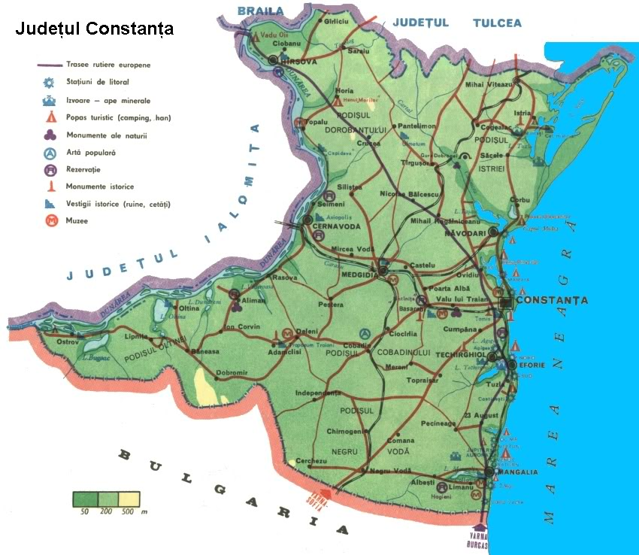
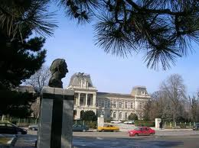
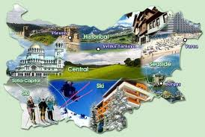
BULGARIA

